Slide 1

Analyzing the Successfulness of Crowdfunding Projects on Kickstarter
Course: BIA 652
Date: May 6, 2019
Authors: Tianrui Wang & Zi-Qi Liu Instructor: Prof. David Belanger

Slide 2
Index
Introduction
Project Flow
Exploratory Data Analysis
Results
Conclusion & Future Work

Slide 3
Introduction
Kickstarter is the world's largest funding platform for creative projects, it works on an all-or-nothing basis i.e if a project doesn’t meet its goal by the deadline, the project owner gets nothing.
Our project digs into which specific characters lead to a successful fundraising for a project, hoping to provide a reference for the Kickstarter community.
Data Source: Kaggle- kickstarter-projects
Keywords: Data Mining, Clustering, Classification, R, Tableau

Slide 4
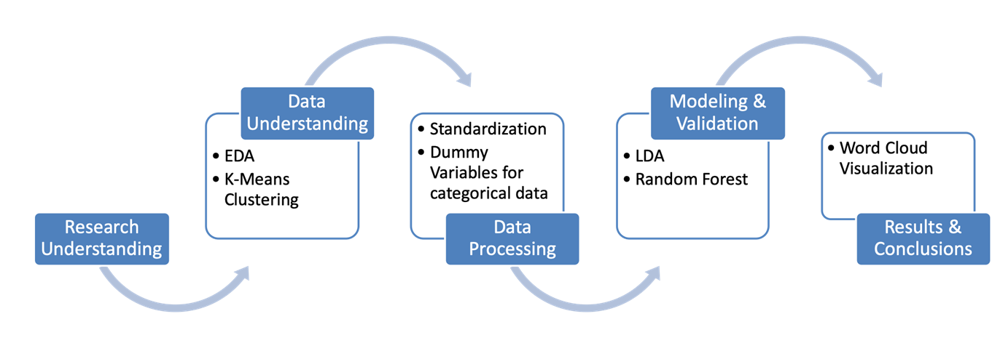
Project Flow

Slide 5
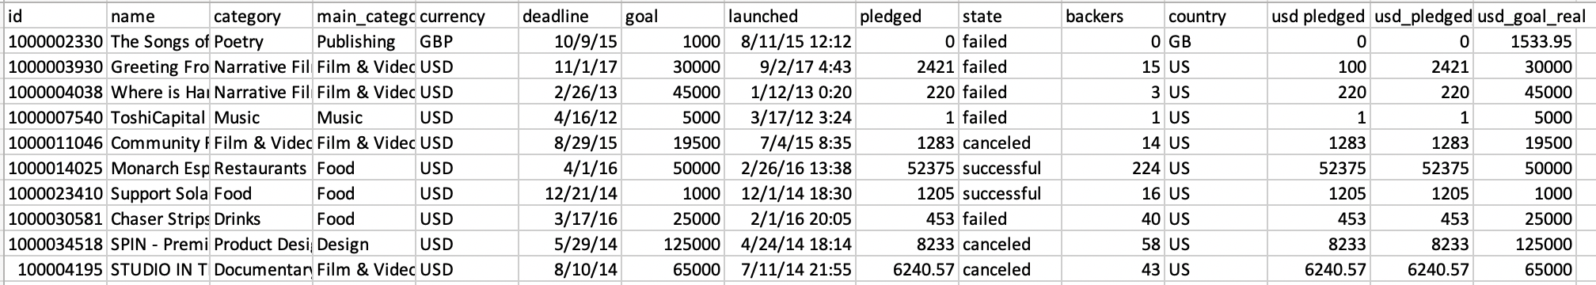
Dataset at a Glance
378661 Rows X 15 Variables
Target Variable: state ( successful, failed, canceled, suspended, live, undefined)

Slide 6
Exploratory Data Analysis
The projects are divided into 15 main categories and 159 sub- categories. Among all the variables, pledged, goal, backers (supporters) and days of duration are the most important numerical variables.

Slide 7
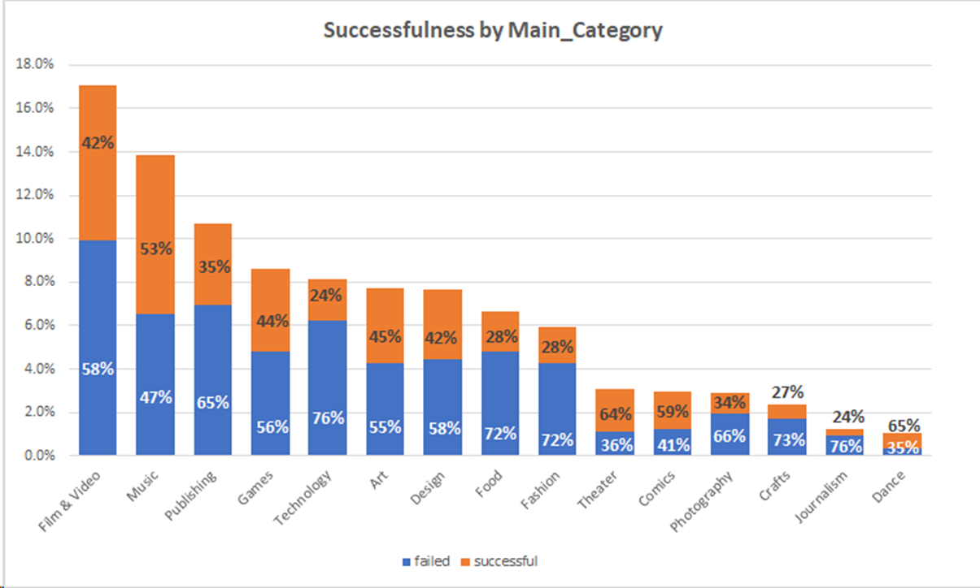
Exploratory Data Analysis

Slide 8
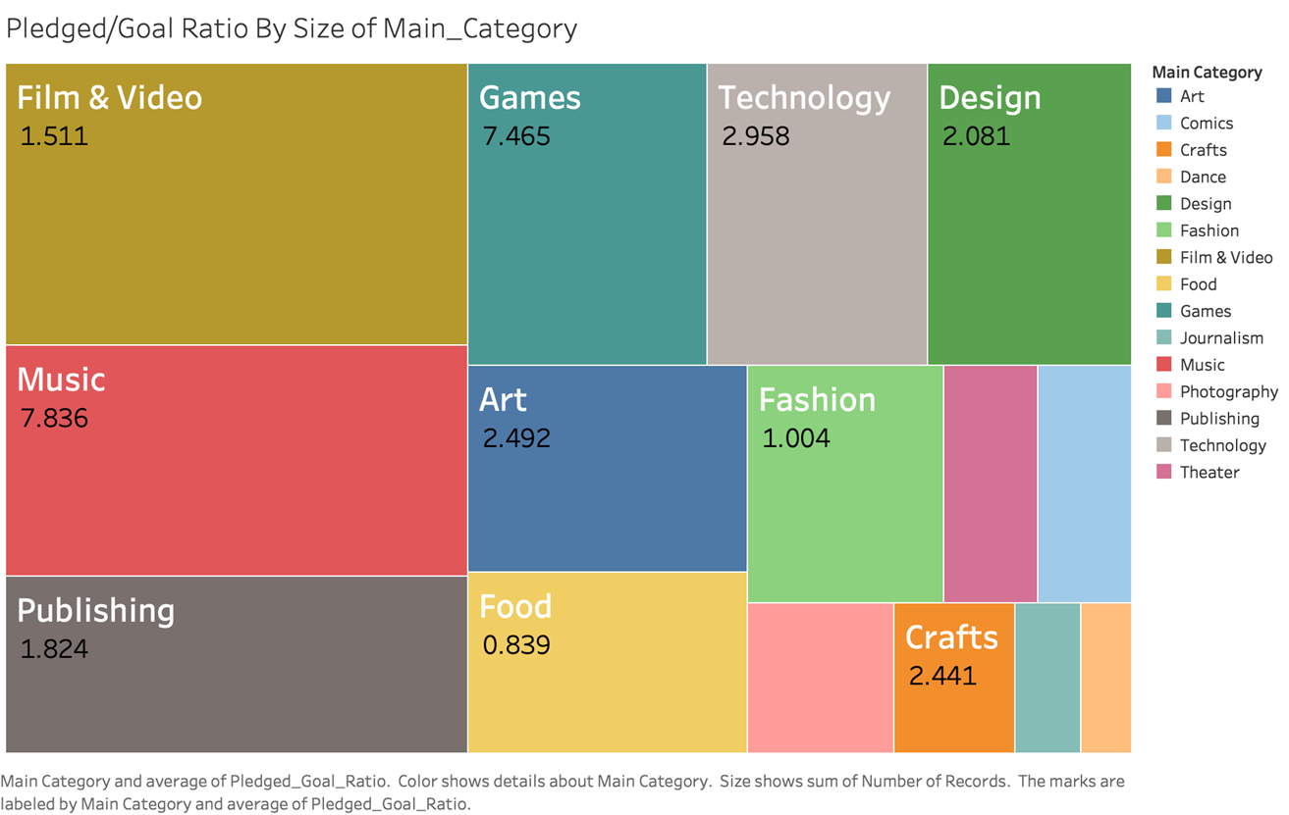
Exploratory Data Analysis

Slide 9
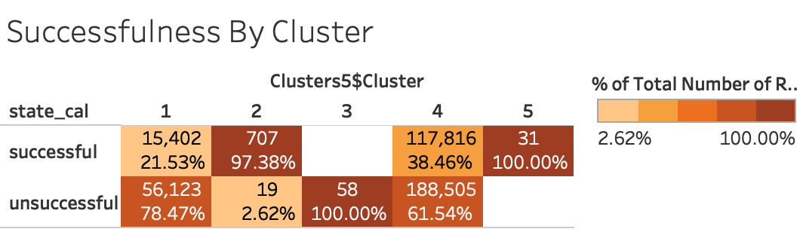
Cluster Analysis: K - Means ( k = 5 )
While Cluster#1 & #4 represented the crowded majority, Cluster#2,#3, #5 was perfectly separated.

Slide 10
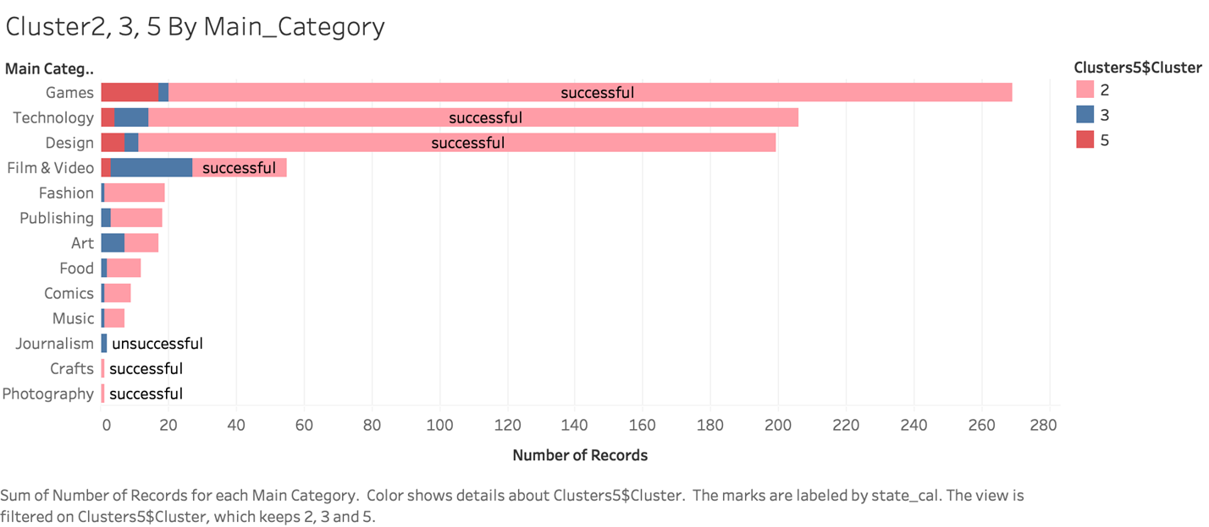
Cluster Analysis: K - Means ( k = 5 )

Slide 11
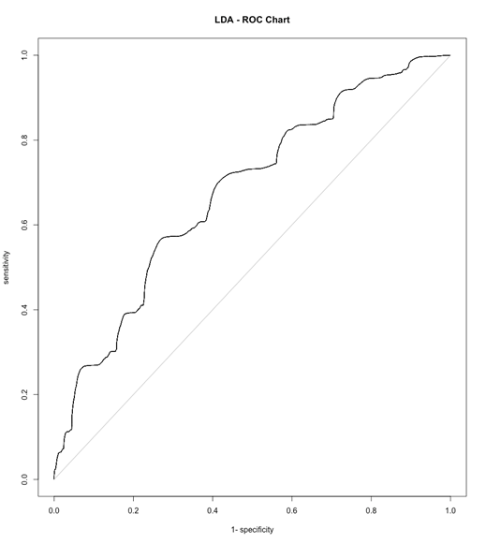
Results
LDA
The result of LDA yields an accuracy of 66.25%. Among all other variables, the coefficient of Technology, Dance, Theater & Journalism ranked top.

Slide 12
Results
Random Forest
As the amount of trees increased, the error of the model decreased and stabilized at 0.02%. The most important variables are Pledged, Backers, Goal, and Days. Moreover, some categories have larger impact than others. Accuracy = 98.5%

Slide 13
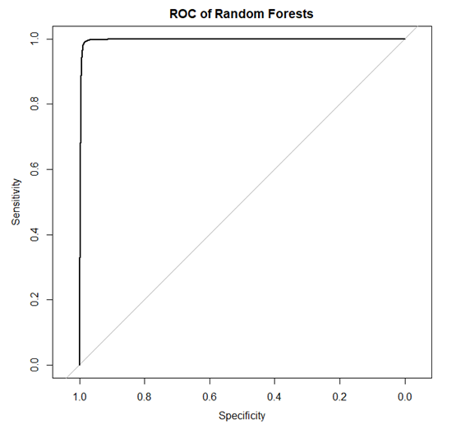
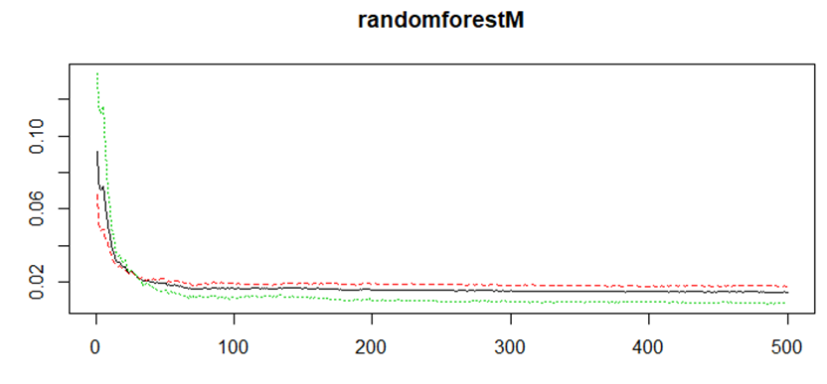
Results

Slide 14
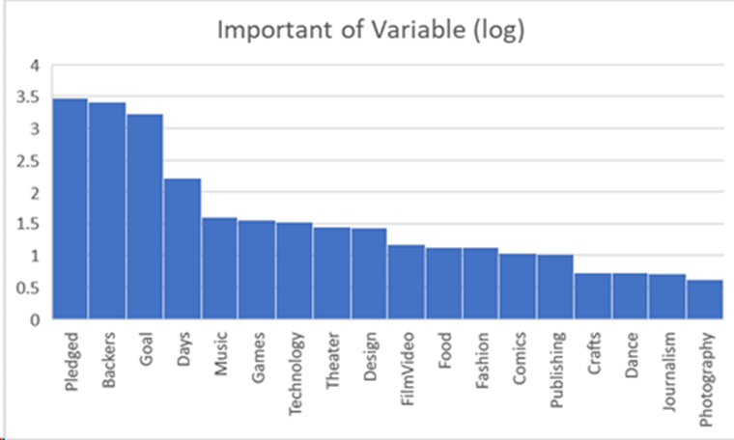
Results

Slide 15
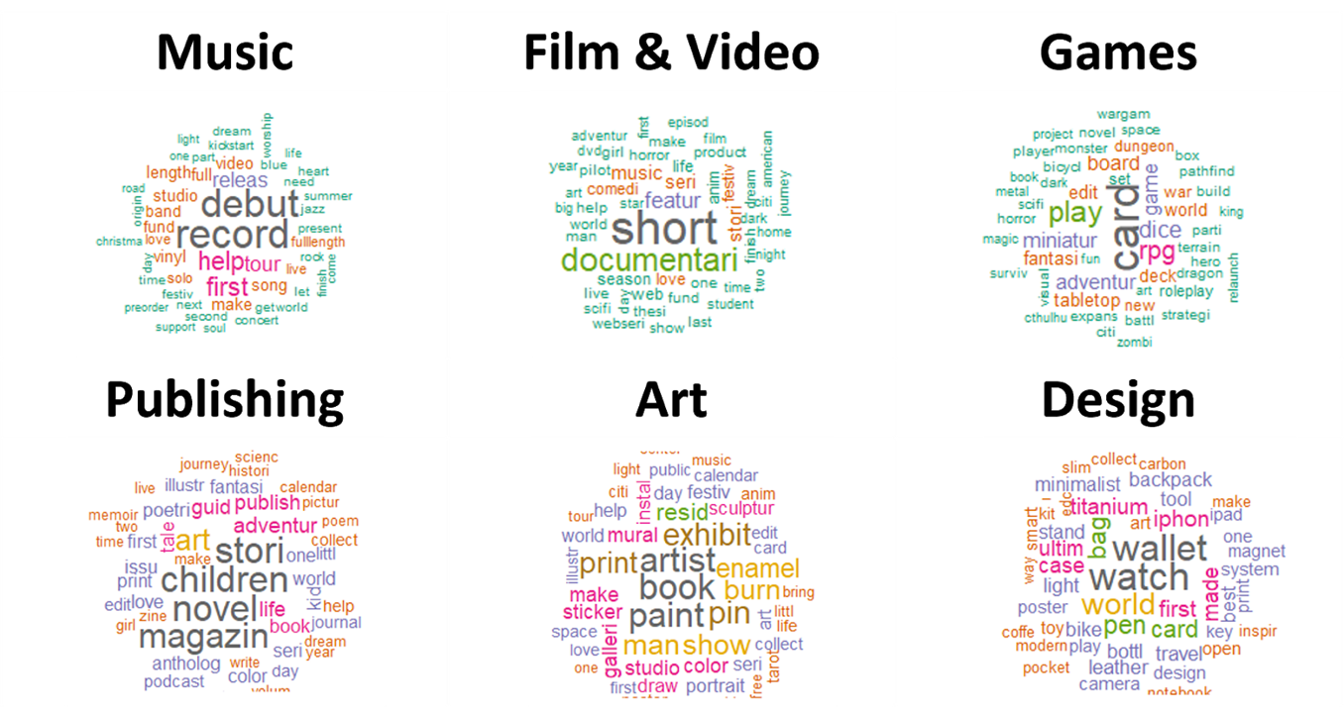
Results-Word Cloud For Top 6 Categories

Slide 16
Conclusion & Future Work
The result for EDA, Cluster Analysis, LDA and Random Forest are similar. They revealed the same group of categories that attracted a majority of the backers in the Kickstarter Community.
Games, Technology, Design, Film & Video are the majority industries among the most mature projects. These industries have higher barrier-to-entry and require more technology inputs. On one hand, this resulted in many well-prepared projects and their successful fundraising; on the other hand, immature project also exists, which could be a reason balancing out the successfulness in such categories.

Slide 17
Conclusion & Future Work
The World Cloud helps summarized some featured keywords for the top 6 categories, implying majority of the topics within each category. It could be developed to a future research in NLP.
Fun Fact: Cluster#2 & #5 are mainly made up of “outliers” with high goal & pledged. These data are in fact our focus – the ones that “ought to be successful”.

